Slide 1
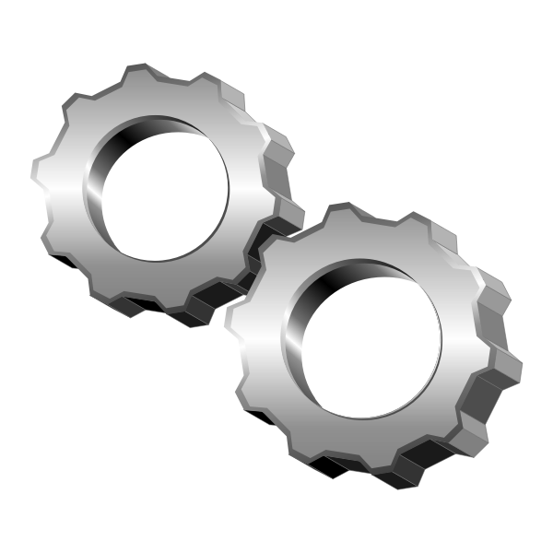
Gym Equipment Availability Reactivity Sensor (GEARS)
Gym Equipment Availability Reactivity Sensor (GEARS)
Team Big Boys: Devyn Strbo, Nathan Rogers, Parker Manson, Josh Miles

Slide 2
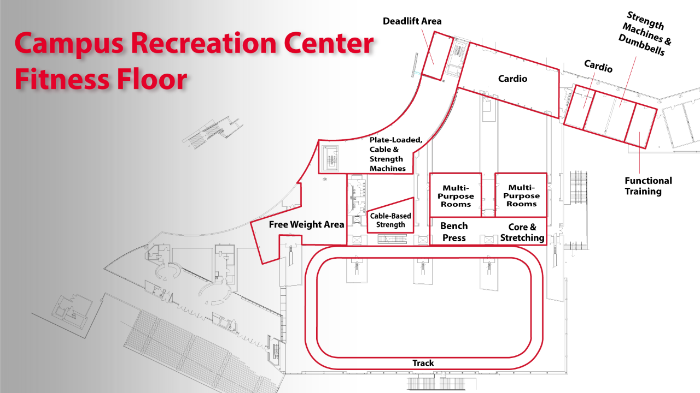
Vision
The purpose of this project is to reduce queue times at gyms by providing information about available equipment.
This product is mainly marketed towards larger commercial gym owners.
This product will have features such as, real time updates and wireless functionality.

Slide 3
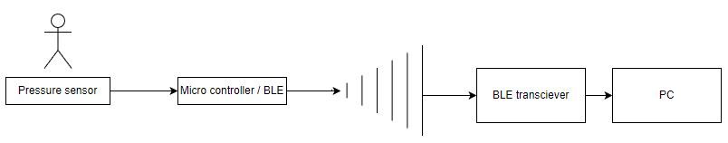
Software Architecture
G.E.A.R.S will be constructed with a pressure sensor imbedded into gym padding. This pressure sensor will send pressure data to a microcontroller which will analyze the pressure data to see how long the gym equipment has been unused for.
From there the microcontroller will send its gym equipment status data to a BLE transceiver.
The BLE transceiver will relay the gym equipment status data to another BLE transceiver connected to a PC.
Finally, the PC will take in the status data and update an application inside the PC.

Slide 4
Challenges and Risks
Our team believes one of the most serious challenges we will see in developing this product is working with the pressure sensor to use weight and time to determine the formula we will use to see if the user is still using the machine.
We decided the best way to tackle this is simply by trial and error. Going through each of the possible situations so that there are no results our software cannot account for.
Notes:
josh

Slide 5
